Slide 1
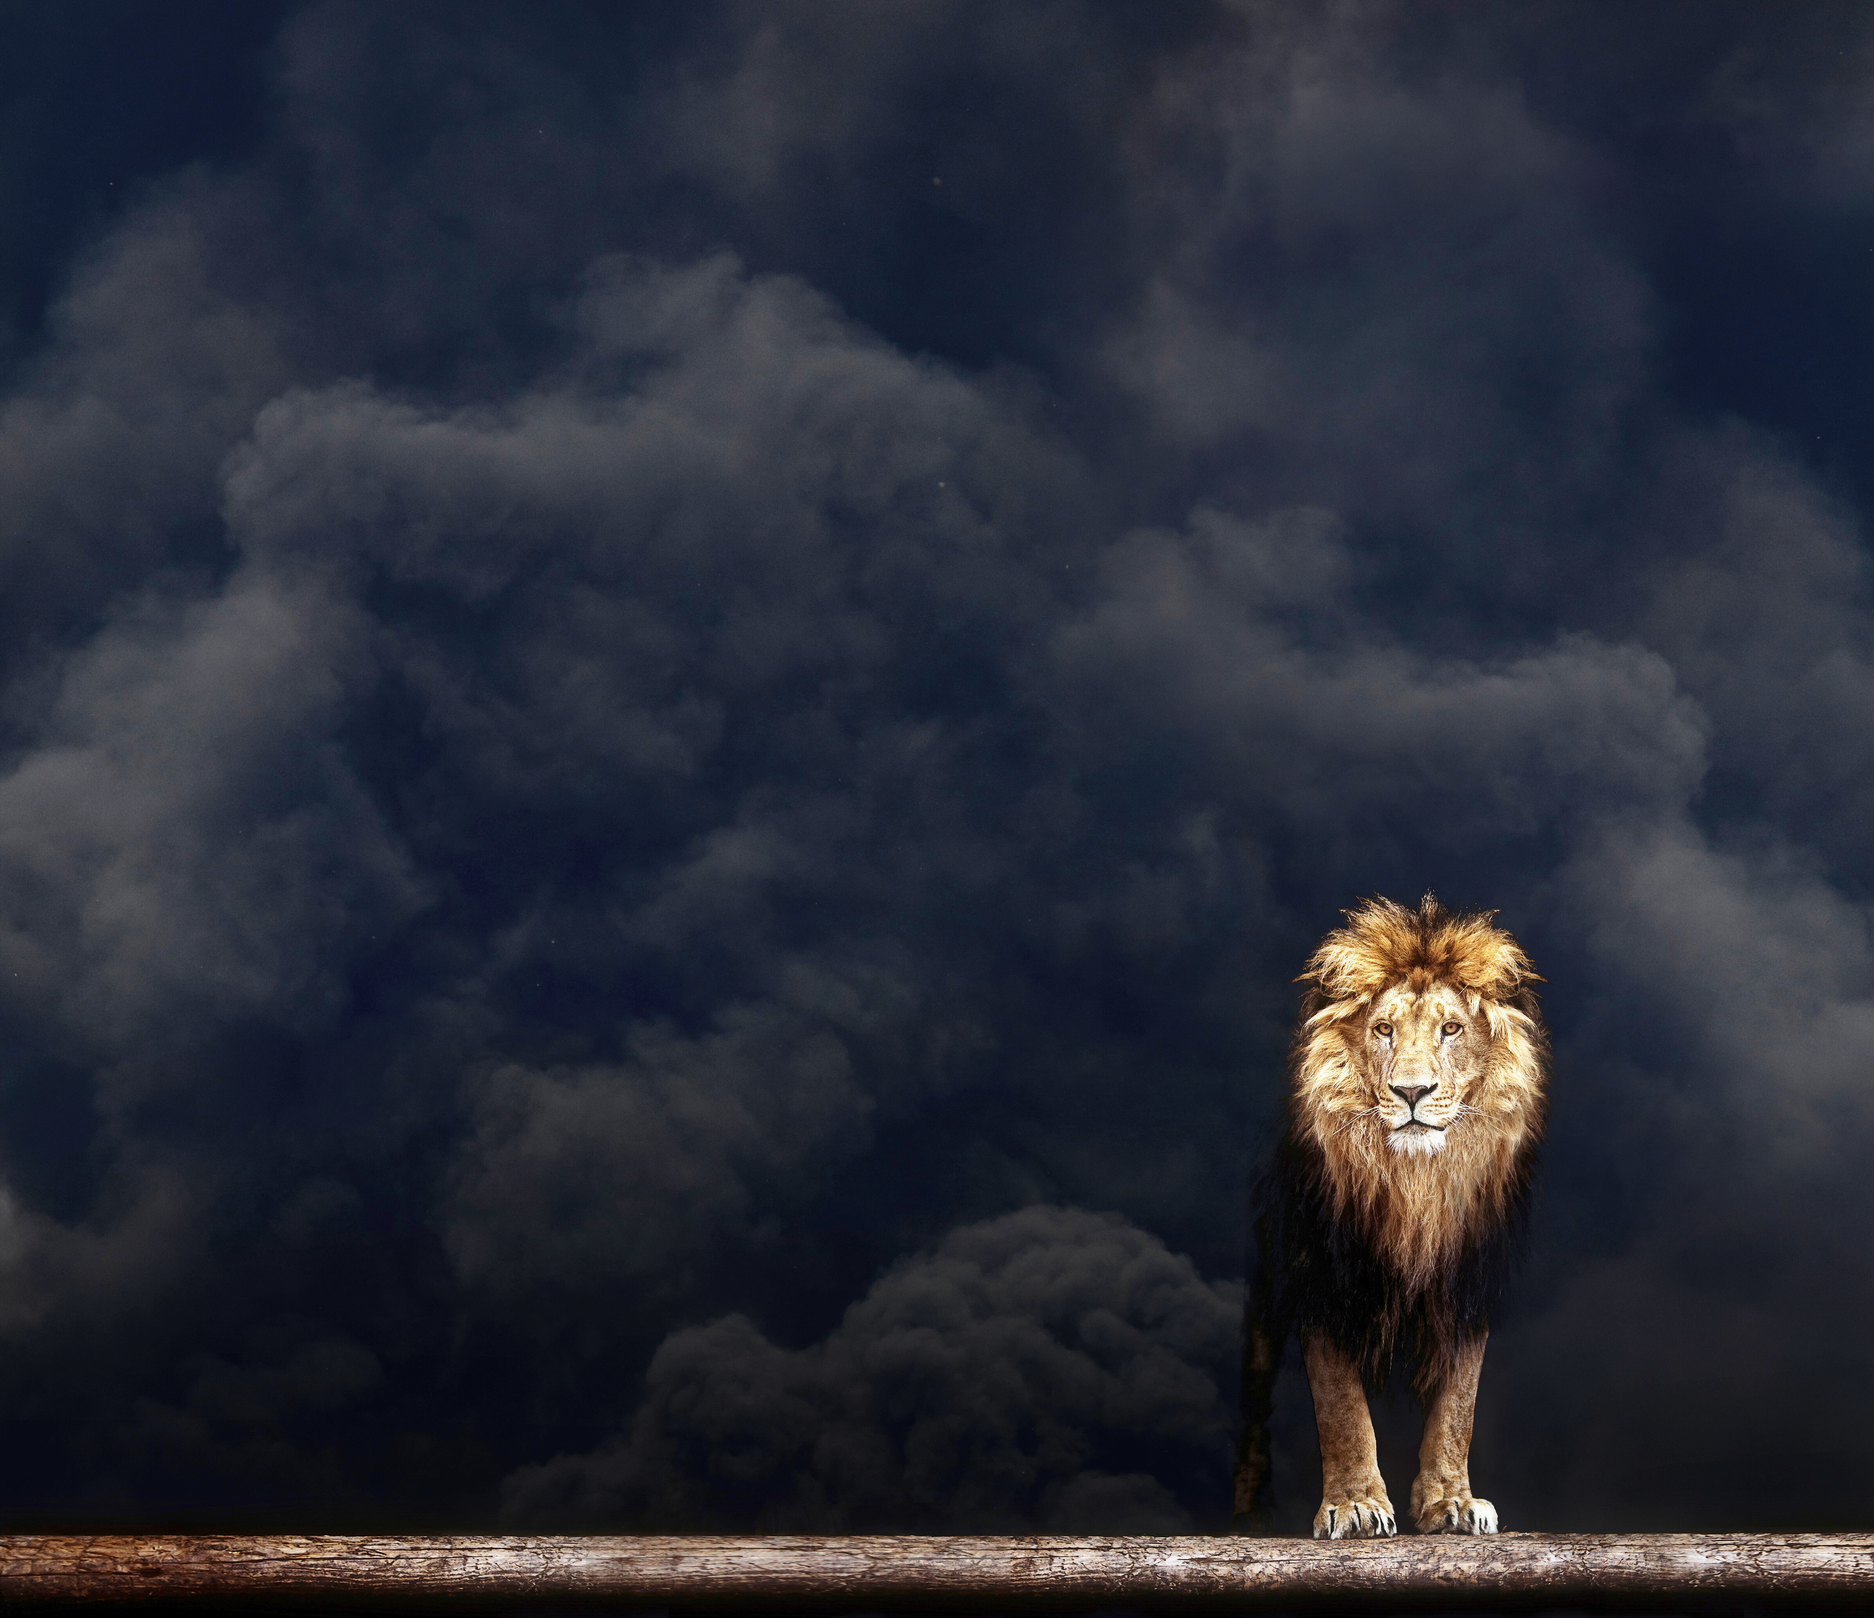



The study of Matthew
Salty and Shining:
Blessed are the Kingdom’s World Changers
Matthew 5:1-16
Ps Lim Wei-en

Slide 2

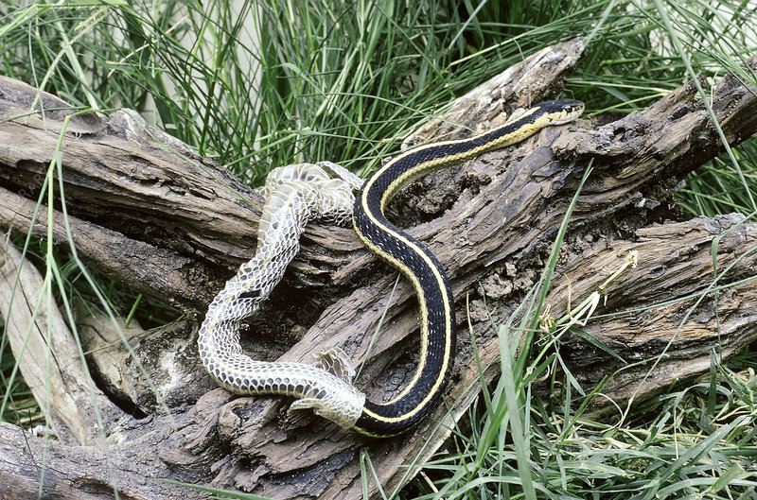
Image from: https://www.sciencephoto.com/media/380108/view

Slide 3
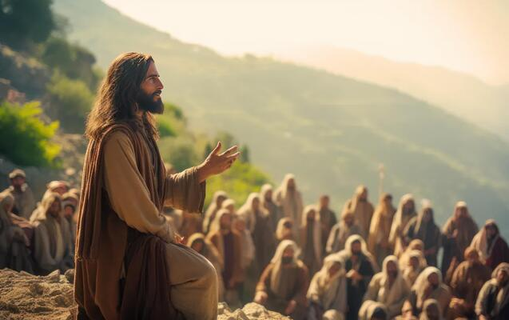
RECAP
Large crowds from Galilee, the Decapolis, Jerusalem, Judea and the region across the Jordan followed him. (4:25)
Now when Jesus saw the crowds, he went up on a mountainside and sat down. His disciples came to him, and he began to teach them. (5:1)

Slide 4
Sermon on the Mount (Matt 5-7)
Matt 5-7
1st Discourse
Matt 10
2nd Discourse
Matt 13
3rd Discourse
Matt 18
4th Discourse
Matt 24-25
5th Discourse

Slide 5
THREE OBSERVATIONS ON THE BEATITUDES
The Beatitudes are an interconnected whole.

Slide 6
THREE OBSERVATIONS ON THE BEATITUDES
The Beatitudes are an interconnected whole.
³ “Blessed are the poor in spirit,
for theirs is the kingdom of heaven.
⁴ Blessed are those who mourn,
for they will be comforted.
⁵ Blessed are the meek,
for they will inherit the earth.
⁶ Blessed are those who hunger and thirst for righteousness,
for they will be filled.
⁷ Blessed are the merciful,
for they will be shown mercy.
⁸ Blessed are the pure in heart,
for they will see God.
⁹ Blessed are the peacemakers,
for they will be called children of God.
¹⁰ Blessed are those who are persecuted because of righteousness,
for theirs is the kingdom of heaven.

Slide 7
THREE OBSERVATIONS ON THE BEATITUDES
The Beatitudes are an interconnected whole.
³ “Blessed are the poor in spirit,
for theirs is the kingdom of heaven.
⁴ Blessed are those who mourn,
for they will be comforted.
⁵ Blessed are the meek,
for they will inherit the earth.
⁶ Blessed are those who hunger and thirst for righteousness,
for they will be filled.
⁷ Blessed are the merciful,
for they will be shown mercy.
⁸ Blessed are the pure in heart,
for they will see God.
⁹ Blessed are the peacemakers,
for they will be called children of God.
¹⁰ Blessed are those who are persecuted because of righteousness,
for theirs is the kingdom of heaven.

Slide 8
THREE OBSERVATIONS ON THE BEATITUDES
“Blessed” doesn’t’ refer to what we think but what God thinks of our situation.
“Makarios” – Not so much “happy” as “approved”.

Slide 9
THREE OBSERVATIONS ON THE BEATITUDES
The Beatitudes cannot be separated from the Gospel.
“Repent, for the kingdom of heaven has come near.” (4:17)

Slide 10

THE BEATITUDES (5:3-12)
“Blessed are the poor in spirit,
for theirs is the kingdom of heaven.

Slide 11
THE BEATITUDES (5:3-12)
“Let not the wise boast of their wisdom
or the strong boast of their strength
or the rich boast of their riches,
but let the one who boasts boast about this:
that they have the understanding to know me,
that I am the Lord, who exercises kindness,
justice and righteousness on earth,
for in these I delight,”
declares the Lord. (Jer. 9:23-24)
‘You say, I am rich, I have prospered, and I need nothing; not knowing that you are wretched, pitiable, poor, blind, and naked.’ (Rev. 3:17)

Slide 12
THE BEATITUDES (5:3-12)
“Blessed are those who mourn,
for they will be comforted.

Slide 13
THE BEATITUDES (5:3-12)
“Blessed are the meek,
for they will inherit the earth.

Slide 14
THE BEATITUDES (5:3-12)
Now if we are children, then we are heirs—heirs of God and co-heirs with Christ… (Rom. 8:17)
…but in these last days he has spoken to us by his Son, whom he appointed heir of all things, and through whom also he made the universe. (Heb. 1:2)

Slide 15
THE BEATITUDES (5:3-12)
“Blessed are those who hunger and thirst for righteousness, for they will be filled.

Slide 16
THE BEATITUDES (5:3-12)
“You will seek me and find me when you seek me with all your heart.” (Jer. 29:13)
“Ask and it will be given to you; seek and you will find; knock and the door will be opened to you.” (Matt. 7:7).

Slide 17
THE BEATITUDES (5:3-12)
“Blessed are the merciful,
for they will be shown mercy.

Slide 18
THE BEATITUDES (5:3-12)
When we who have sinned against God ask him for his undeserved mercy, yet at the same time refuse to extend mercy to others, we are not at that moment asking God for mercy.

Slide 19
THE BEATITUDES (5:3-12)
“Blessed are the pure in heart,
for they will see God.

Slide 20
THE BEATITUDES (5:3-12)
“the pure in heart are ‘the utterly sincere. Their whole life, public and private, is transparent before God and men. Their very heart—including their thoughts and motives—is pure, unmixed with anything devious, ulterior or base. Hypocrisy and deceit are abhorrent to them; they are without guile.”
(John Stott, The Message of the Sermon on the Mount)

Slide 21
THE BEATITUDES (5:3-12)
Dear friends, now we are children of God, and what we will be has not yet been made known. But we know that when Christ appears, we shall be like him, for we shall see him as he is. All who have this hope in him purify themselves, just as he is pure. (1 Jn. 3:2-3)

Slide 22
THE BEATITUDES (5:3-12)
“Blessed are the peacemakers,
for they will be called children of God.

Slide 23
THE BEATITUDES (5:3-12)
All this is from God, who reconciled us to himself through Christ and gave us the ministry of reconciliation: that God was reconciling the world to himself in Christ, not counting people’s sins against them. And he has committed to us the message of reconciliation. We are therefore Christ’s ambassadors, as though God were making his appeal through us. (2 Cor. 5:18-20)

Slide 24
THE BEATITUDES (5:3-12)
“Blessed are those who are persecuted because of righteousness, for theirs is the kingdom of heaven.
Blessed are you when people insult you, persecute you and falsely say all kinds of evil against you because of me. Rejoice and be glad, because great is your reward in heaven, for in the same way, they persecuted the prophets who were before you.

Slide 25
ON EARTH AS IT IS IN HEAVEN
Jesus Kingdom will be established on earth through Kingdom followers who live distinctively and serve others.

Slide 26
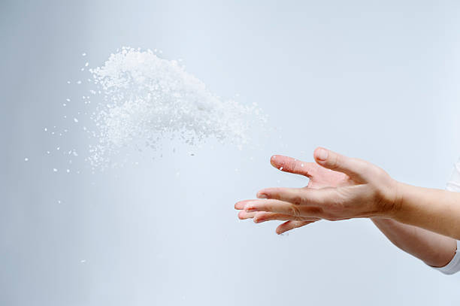
SALTY AND SHINING (5:13-16)
“You are the salt of the earth. But if the salt loses its saltiness, how can it be made salty again? It is no longer good for anything, except to be thrown out and trampled underfoot.

Slide 27
SALTY AND SHINING (5:13-16)
The glory of the gospel is that when the Church is absolutely different from the world, she invariably attracts it. It is then that the world is made to listen to her message, though it may hate it at first. (Martin Lloyd Jones)

Slide 28
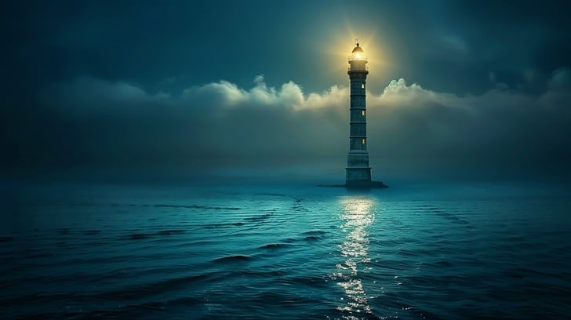
SALTY AND SHINING (5:13-16)
“You are the light of the world. A town built on a hill cannot be hidden. Neither do people light a lamp and put it under a bowl. Instead, they put it on its stand, and it gives light to everyone in the house. In the same way, let your light shine before others, that they may see your good deeds and glorify your Father in heaven.

Slide 29
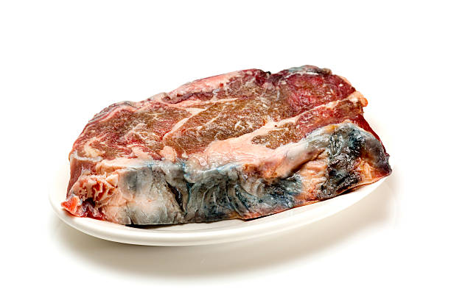

SALTY AND SHINING (5:13-16)
If the world is not changed, we need to take a good look at ourselves and ask, “what has happened to our saltiness? What has happened to our brightness?”

Slide 30
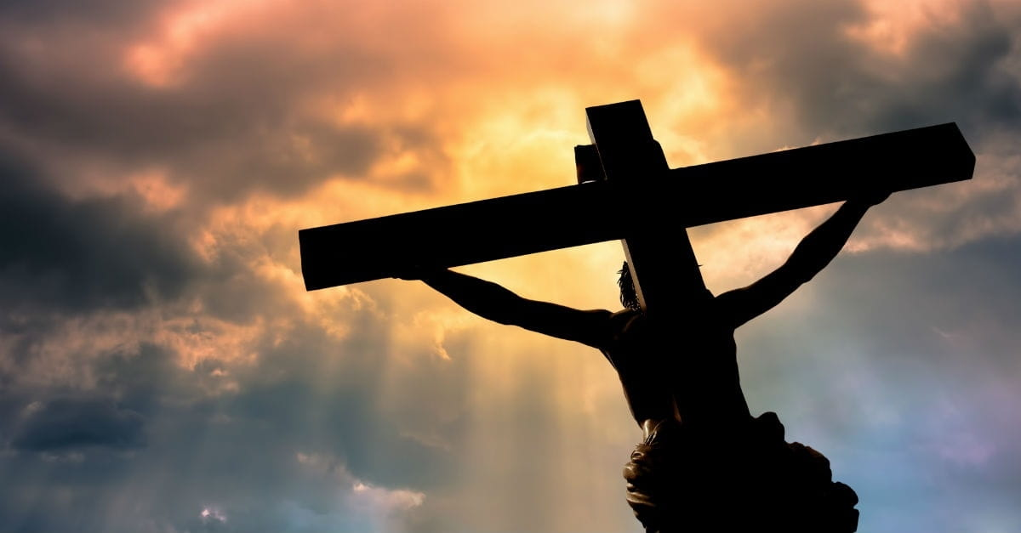
THE BLESSED KING
Jesus was and is:
Poor in spirit
One Who Mourns
Meek
One Who hungers and thirsts for righteousness
Merciful
Pure in heart
A Peacemaker
Persecuted for righteousness' sake

Slide 31
FOR REFLECTION AND DISCUSSION
Which of these beatitudes point to evidence of King Jesus already working in us?
Which of these show us that we still need King Jesus to work deeply in us?
Name one way you can begin to be distinctive (salt) and serve others (light) in your context?

